Slide 1
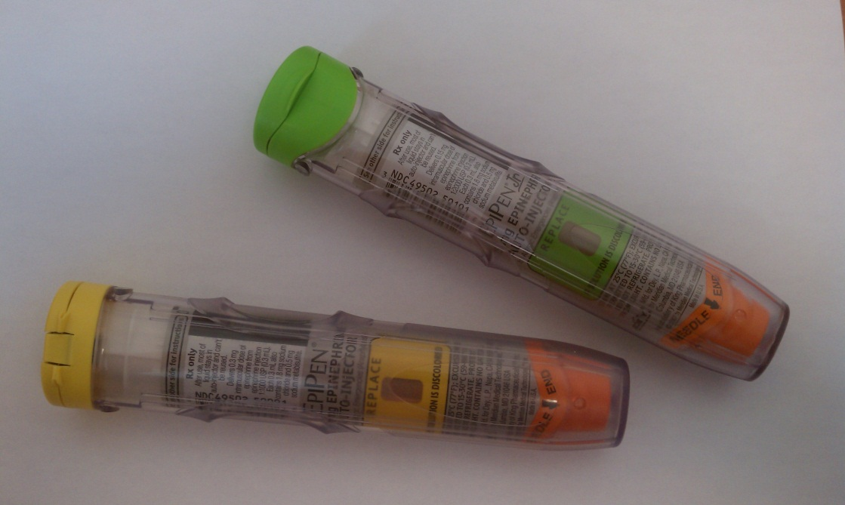
Allergies and Epi-Pens
Schaefferstown EMS

Slide 2
Pharmacology
Sympathomimetic
Mimic or stimulate the response of the body’s sympathetic nervous system
Adrenaline – Hormone is a hormone produced by the body that is released when the body is stressed, resulting in an increased heart rate and the transfer of glycogen into glucose – fuel that the body can use during a stress episode.

Slide 3
Pharmacology
Mechanism of Action
Dilates bronchioles
Constricts blood vessels
Has a rapid onset when administered SQ or IM, but has a short duration

Slide 4
Pharmacology
Side Effects
Increased heart rate
Palpitations
Pallor
Dizziness
Chest Pain
Headache
Nausea/Vomiting
Anxiousness
Sweating
Dilated pupils

Slide 5
Pharmacology
Contraindications
NONE WHEN USED IN A LIFE THREATENING SITUATION!!!!
Relative contraindications
Stroke or heart attack may occur in elderly patients or patients with a history of heart disease or hypertension
Incompatibilities
Prolonged light exposure
Low temperatures

Slide 6
About the Epi-Pen(s)
Form
Injectible sterile solution packaged in a disposable delivery system featuring spring activation and a concealed needle

Slide 7
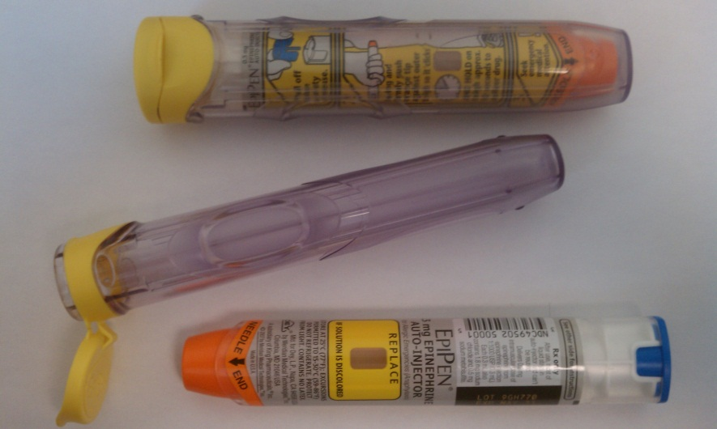
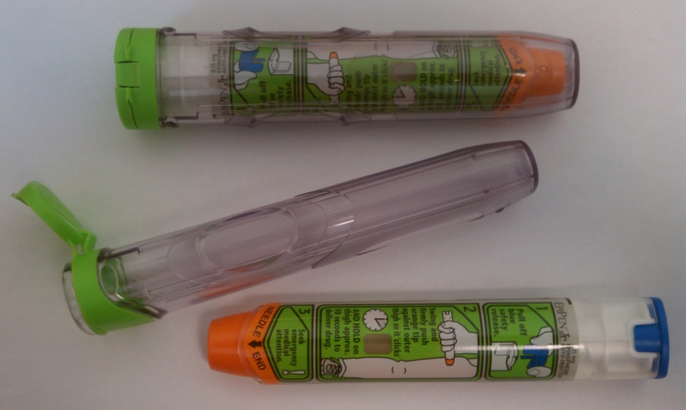
About the Epi-Pen(s)
Adult Epi-Pen
0.3 mg in 0.3 ml
Epi-Pen Jr.
0.15 mg in 0.3 ml

Slide 8
Care and Storage
Store in a dark place at room temp.
DO NOT refrigerate
DO NOT expose to extreme cold or heat
Check expiration dates often
Ensure clear window often
Replace if solution appears cloudy or contains solid particles
Plastic carrying tube provides UV protection

Slide 9
Allergic Reaction
An exaggerated immune system response to any substance
Causes can include: Insect bites and stings, Plants, Medications, Food (nuts, dairy), and anything else you can think of!

Slide 10
Physical Findings - Skin
Itching
Hives
Red Skin (flushing)
Swelling to the face, neck, hands, feet, and/or tongue
Patient may also report a warm tingling feeling in the face, mouth, chest, feet, and hands

Slide 11
Physical Findings – Respiratory
Tightness in the throat or chest
Cough
Rapid breathing
Labored breathing
Noisy breathing
Hoarseness in the voice
Stridor
Difficulty swallowing
Wheezing that is audible without a stethoscope

Slide 12
Physical Findings - Cardiac
Increased Heart Rate
Irregular Heart Rhythm
Decreased Blood Pressure

Slide 13
Physical Findings – Mental Status
Decreasing level of consciousness

Slide 14
Physical Findings - General
Itchy, watery eyes
Headache
Runny nose
Sense of impending doom

Slide 15
Emergency Assessment and Treatment
Initial Assessment
Focused History and Physical Exam
History of any allergies
What the patient was exposed to
How they were exposed
Progression
Interventions
Provide supportive airway care
High flow oxygen!

Slide 16
Emergency Assessment and Treatment
Baseline vital signs and SAMPLE history

Slide 17
Epi-Pen or NO Epi-Pen?
Moderate Reaction
Severe Reaction
Mild shortness of breath with or without wheezing
Extensive hive and itching
Mild tongue/lip swelling without any difficulty swallowing
Contact Medical Command for further directions
Difficulty breathing and wheezing/stridor
Severe hives
Swollen tongue/lips, difficulty swallowing
Hypotension
Decreased mental status
Administer Epi-Pen!!!
Adult dose: 0.3mg (Epi-Pen)
Peds dose: 0.15mg (Epi-Pen Jr.)

Slide 18
Epi-Pen or NO Epi-Pen?
For patient’s with mild reactions (minor hives or redness with no other symptoms), observe for any change in condition and continue to monitor vital signs every 5 minutes

Slide 19
Emergency Assessment and Treatment
Contact Medical Command for Moderate Reaction
Follow directions given by Medical Command
If unable to contact Medical Command and patient has:
Generalized hives or swelling to face, neck, tongue, or extremities.
And/Or Stridor, wheezing, or tightness in throat/chest
And/Or Decreased mental status
And/Or Signs of shock or respiratory compromise
Proceed with administration of Epi-Pen!
Patient weighing less than 30 kg (65 lbs)
0.15mg=0.3ml of 1:2000 solution of Epinephrine
Patient weighing more than 30 kg (65lbs)
0.30mg=0.3ml of 1:1000 solution of Epinephrine

Slide 20
Emergency Assessment and Treatment
Repeat physical assessment every 5 minutes and attempt to contact Medical Command every 5 minutes
Documentation
Appropriate indications for use
Any adverse events
Dosage, route, and response
Repeat assessments and treatment outcomes

Slide 21
Giving the Epi-Pen
Exam Epi-Pen for cloudiness, discoloration, any damage, expiration date, and correct drug, dose, route.
Remove cap from auto-injector
Identify proper site for injection
Lateral portion of patient’s thigh
Midway between the waist and knee

Slide 22
Giving the Epi-Pen
Injection technique:
Push the auto-injector against the thigh until the injector activates
Hold in place for 5-10 seconds
Document site, response, and side effects
Record activity and time
Place used auto-injector in approved sharps container

Slide 23
Reassessment
Transport
Continue assessment of ABC’s
If patient improves:
Provide supportive care
Oxygen
Treat for shock if needed

Slide 24
Reassessment
If the patient gets worse:
Contact Medical Command
Administer second dose of Epi-Pen, if directed
Treat for shock
Administer Oxygen
CPR and AED if needed

